Slide 1
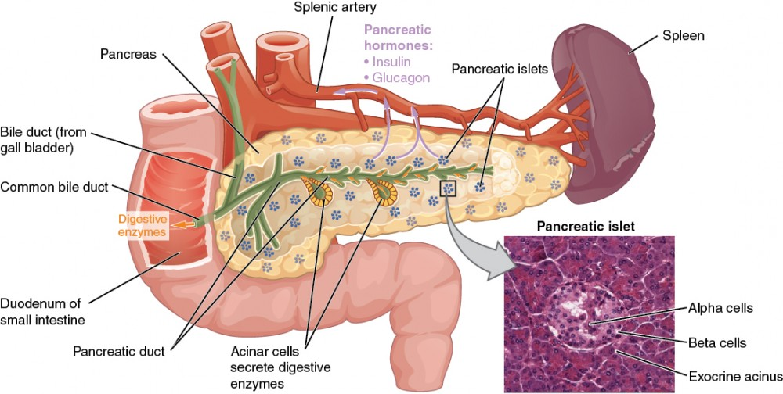
β-cell Bedlam!
Biomolecules and Cells
Synchronous 1.2
https://courses.lumenlearning.com/suny-ap2/chapter/the-endocrine-pancreas/

Slide 2
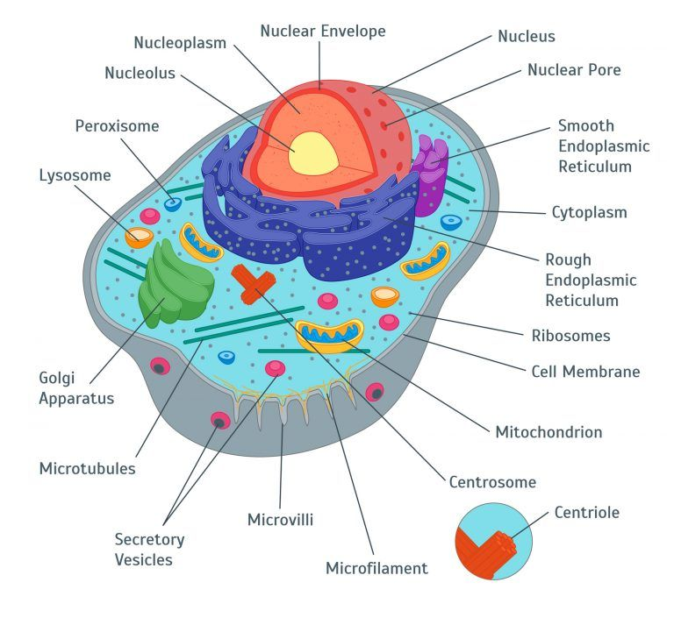
Animal Cells
Do you know these structures?
Do you know how they fit together?
Biomolecules & Cells > Animal Cell Cycle > β-cell Bedlam!
https://kidsbiology.com/biology-basics/cell-organelles/

Slide 3
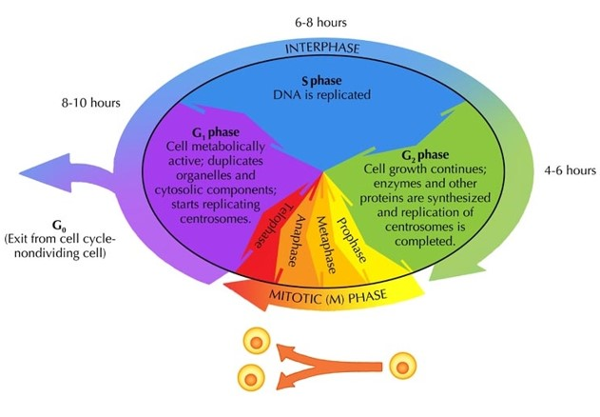
Cell cycle
Do you know this order?
Do you know how the phases are regulated?
Biomolecules & Cells > Animal Cell Cycle > β-cell Bedlam!
http://nnhsbiology.pbworks.com/w/page/12388761/cell%20cycle%20and%20mitosis

Slide 4
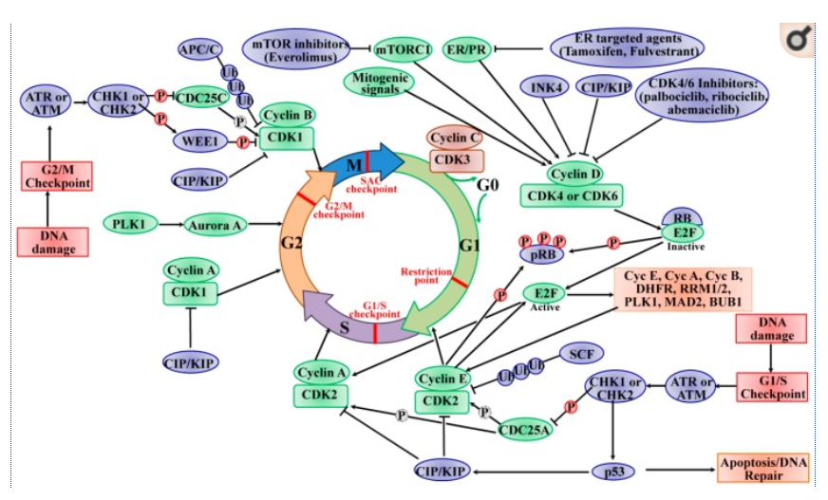
Some closer details regarding regulation…
Biomolecules & Cells > Animal Cell Cycle > β-cell Bedlam!

Slide 5
How this is going to work
This is a “pick your own” adventure through the cell.
You can follow the “cell cycle” or “insulin production” pathways
Your cell/protein can die/degrade, you need to pick the correct options to divide/ exocytose!
Biomolecules & Cells > Animal Cell Cycle > β-cell Bedlam!

Slide 6
We will…
Go inside a pancreatic β-cell,
Follow its cell cycle,
Consolidating the Introduction to Cell Cycling lesson
Look at what happens when glucose is detected,
Follow the path of an insulin protein from transcription to secretion.
Linking the parts of the Animal Cells lesson
Biomolecules & Cells > Animal Cell Cycle > β-cell Bedlam!

Slide 7
Beta-cells
Which process would you like to undertake?
Cell division Insulin production
Biomolecules & Cells > Animal Cell Cycle > β-cell Bedlam!

Slide 8
Cell division
Growing organs require a great deal of cell division, but once grown there are limit situations when beta-cells grow (~1% for damage repair)
What is your age?
Infant Adult
Biomolecules & Cells > Animal Cell Cycle > β-cell Bedlam!

Slide 9
Initiation of division
In normal cell, cell division is halted (G₀), so the cells can be focused on their task of producing insulin in response to food.
In an infant, there is an obvious need for growth. There are a number of checkpoints to check for errors. In the first stage (G₁), the size of the cells increase due to the production of proteins. In the second stage (S) DNA is replicated. Progression is due to protein regulation…
The cell arrives at the G₁-S checkpoint, you must choose a signal:
CHK2 activated CyclinE-CDK2 activated
Biomolecules & Cells > Animal Cell Cycle > β-cell Bedlam!

Slide 10
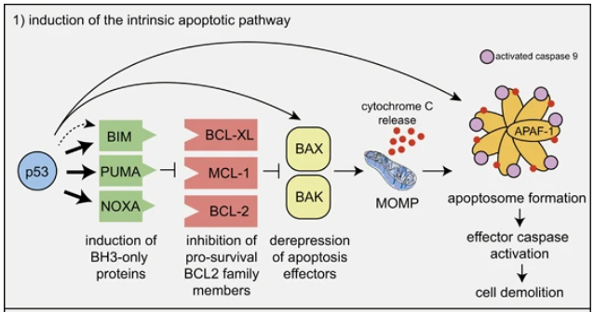
You have entered the apoptotic pathway.
The CHK2 protein has detected that there is an issue with the DNA.
The cell cycle regulator protein p53 has been activated and triggered the caspase cascade.
Your cell has died and will be recycled by the immune system. Learn more?
GAME OVER. Try again
Biomolecules & Cells > Animal Cell Cycle > β-cell Bedlam!

Slide 11
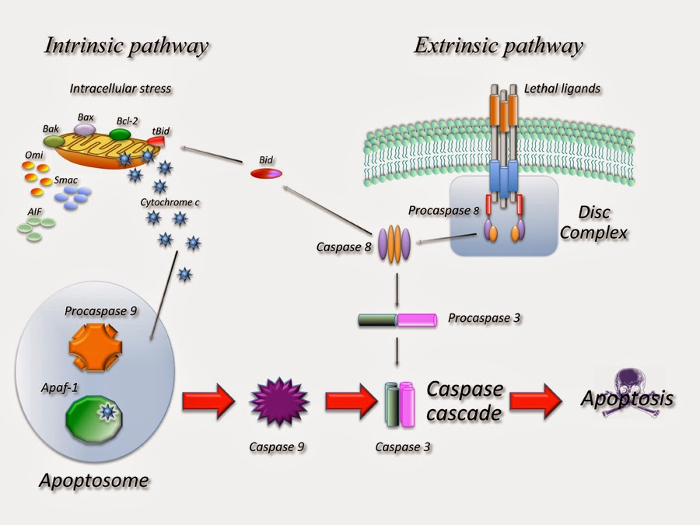
Apoptosis
Intrinsic pathway:
Activated in response to
DNA damage,
loss of cell-survival factors or
other types of severe cell stress.
Pro-apoptotic proteins are released from the mitochondria to activate caspase proteases and trigger apoptosis.
Biomolecules & Cells > Animal Cell Cycle > β-cell Bedlam!

Slide 12
Progression of division
With the activation of the CyclinE-CDK2 complex, the cell is able to progress into S-phase. This complex activates other growth factors (E2F) that signals the decoupling of CDK2 from CyclinE to CyclinA.
Your cell replicates DNA and progresses into the final stage of interphase (G₂) where the cytoskeleton gears the cell into mitosis.
Do you wish to proceed into M-phase?
No Yes
Biomolecules & Cells > Animal Cell Cycle > β-cell Bedlam!

Slide 13
Welcome to M-phase
The final interphase checkpoint is passed; your cell has produced proteins, doubled the DNA and lipid concentration, and created the cellular framework for mitosis.
Chromosomes condense along the equator of the cell. Microtubules are sent forth from the centrosomes to attach to the centromeres of the chromosomes. The depolymerisation of the microtubules causes DNA to move to the poles of the cell…
Do you take
Chromatids Chromosomes
Biomolecules & Cells > Animal Cell Cycle > β-cell Bedlam!

Slide 14
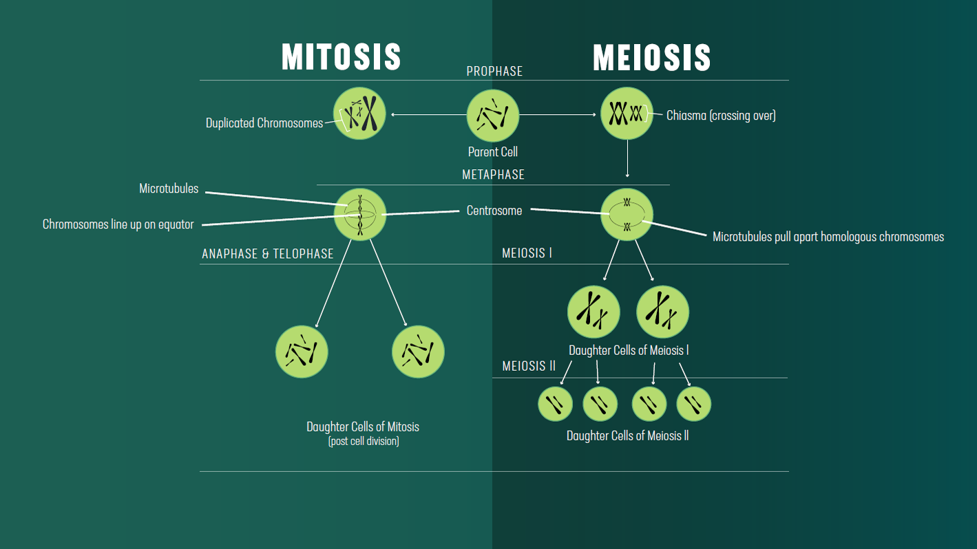
You have entered the Meiosis.
With the alignment of your chromosomes at the equator, something has gone seriously wrong; your pancreas cells are turning to reproductive cells! Abort!
Separating full chromosomes is the first process in making each of your daughter cells haploid
GAME OVER. Try again
Biomolecules & Cells > Animal Cell Cycle > β-cell Bedlam!
https://www.technologynetworks.com/cell-science/articles/mitosis-vs-meiosis-312017

Slide 15
You have made it to the final checkpoint.
You cell has migrated its DNA to the poles of the cells, along with the rest of its duplicated cellular contents, now all that’s left is for the actin belt to form around the equator and perform cytokinesis.
You’ve successfully split your cells.
WAIT! There is one final check to pass…
Are your daughter cells going to be
Haploid Diploid Polyploid
Biomolecules & Cells > Animal Cell Cycle > β-cell Bedlam!

Slide 16
You have survived division.
The final contraction of the actin ring causes the plasma membranes to bud, separating the two cells.
All cellular processes pause.
You and your sister cell have completed cell division.
There is still work to be done.
Will you
Divide again React to glucose stimulation
Biomolecules & Cells > Animal Cell Cycle > β-cell Bedlam!

Slide 17
Initiation of division
In normal cell, cell division is halted (G₀), so the cells can be focused on their task of producing insulin in response to food.
In an adult, the majority of cells are quiescent (active, non-dividing). Some are required for maintenance of the organ.
A mitogenic signal has been triggered.
What is the source?
Damage Glucose
Biomolecules & Cells > Animal Cell Cycle > β-cell Bedlam!

Slide 18
Division commences
In the first stage (G₁), the size of the cells increase due to the production of proteins. In the second stage (S) DNA is replicated. Progression is due to protein regulation…
The cell arrives at the G₁-S checkpoint, you must choose a signal:
CHK2 activated CyclinE-CDK2 activated
Biomolecules & Cells > Animal Cell Cycle > β-cell Bedlam!

Slide 19
Something’s wrong…
Your cell has been found to have errors in the genetic code that means it is not suitable for replication at this time.
Not to panic, repair mechanisms can sort this out, we just need to pause the cell cycle.
Pick a number
1 2 3 4 5 6 7 8 9 10
Biomolecules & Cells > Animal Cell Cycle > β-cell Bedlam!

Slide 20
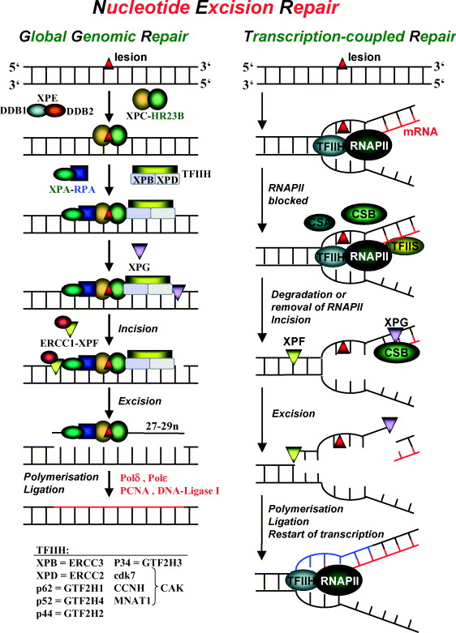
All’s well that ends well.
With the cell cycle halted the cell has a chance to repair the damage.
The cell has identified the DNA error as a lesion and the appropriate mechanisms have been employed.
Phew.
Glad that was found now, could have caused you issues later on!
Continue to S-phase
Biomolecules & Cells > Animal Cell Cycle > β-cell Bedlam!
https://www.sciencedirect.com/science/article/pii/S0300483X03002877

Slide 21
Something’s very wrong…
Er, Houston, we have a problem…
The cell cycle isn’t stopping.
The cyclin-CDK complexes are forming.
Where is the problem?
p53 CHK2
Biomolecules & Cells > Animal Cell Cycle > β-cell Bedlam!

Slide 22
Something’s very VERY wrong…
The issue has been identified. There is a mutation in the CHK2 protein so the cell cycle can’t stop.
At least our backstop is working!
p53 will halt the cycle at a later checkpoint. Waste of energy, but no harm done…
Conclude
Biomolecules & Cells > Animal Cell Cycle > β-cell Bedlam!

Slide 23
Oh dear.
The issue has been identified. There is a mutation in p53 so the cell cycle can’t stop. Ever.
This could be really bad.
The error in the DNA will now be replicated, and the cell cycle cannot be stopped. This cell will keep dividing, with no checks.
Our only hope is that the immune system picks up the error and kills the cell before it’s too late.
Restart
Biomolecules & Cells > Animal Cell Cycle > β-cell Bedlam!

Slide 24
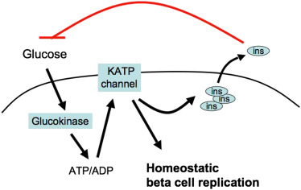
INCOMING!
There is something circulating that threatens the quiet quiescence of the beta cell. Whilst the levels of Cyclin C-CDK3 are high the cells rest unstimulated, but this will not last forever.
The GLUT2 receptors on the cytoplasmic membrane begin to twitch with conformation change.
There is an abundance of glucose. The cell must act.
Will you
Trigger a mitogenic pathway Activate glycolysis
Biomolecules & Cells > Animal Cell Cycle > β-cell Bedlam!
https://www.sciencedirect.com/science/article/pii/S1550413111000854?via%3Dihub#dfig1

Slide 25
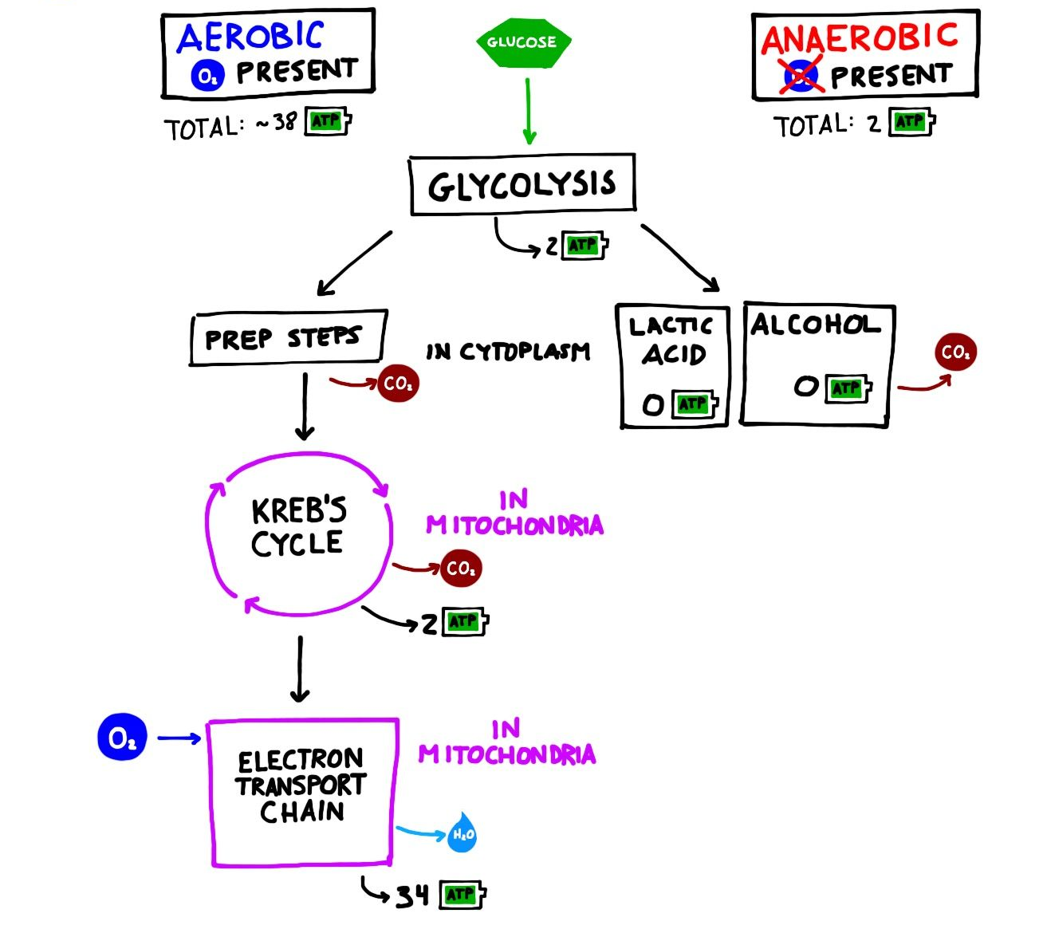
Glycan metabolism
The GLUT2 receptor opens, allowing the glucose to enter the cell. Here, enzymes begin to breakdown the sugar and pass the products to the mitochondria who slavishly churn out the energy currency of the cell:
A_{denosine} T_{ri}P_{hosphate}
How would you like to use the ATP?
Depolarize membrane
Use energy for division
Biomolecules & Cells > Animal Cell Cycle > β-cell Bedlam!
https://www.pinterest.co.uk/pin/577305245954986657/

Slide 26
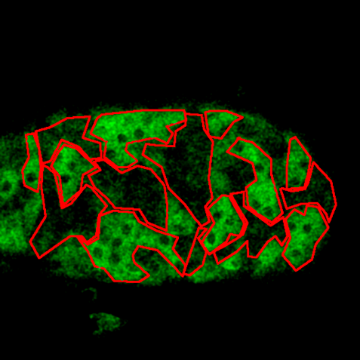
Depolarization!
The increase in glucose causes the glycolytic enzymes and mitochondria to go into overdrive.
ATP begins to flood the cytoplasm threatening to phosphorylate (activate) every signal pathway…but the beta cells have a trick.
The ATP causes the potassium channels to close…
Do you
Divert ATP and reopen them
Flood the cell with signalling molecules
Biomolecules & Cells > Animal Cell Cycle > β-cell Bedlam!
https://journals.plos.org/plosbiology/article?id=10.1371/journal.pbio.0040053

Slide 27
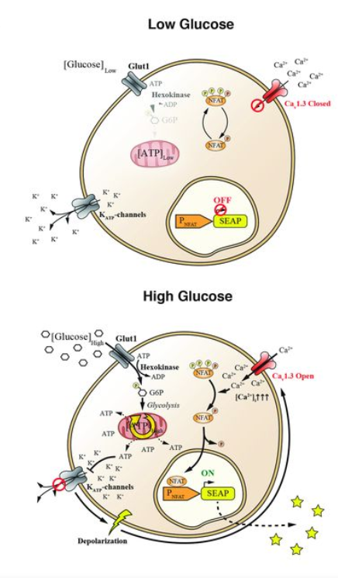
Hyperpolarization!
This change in charge potential forces Calcium channels to open and flood the cell with Ca²⁺ ions.
The Ca²⁺ ions activate a cascade that cause transcription factors travel to the nucleus.
The RNA polymerase enzyme binds to the promotor and preproinsulin mRNA begins to be produced.
Continue
Biomolecules & Cells > Animal Cell Cycle > β-cell Bedlam!
https://science.sciencemag.org/content/354/6317/1296

Slide 28
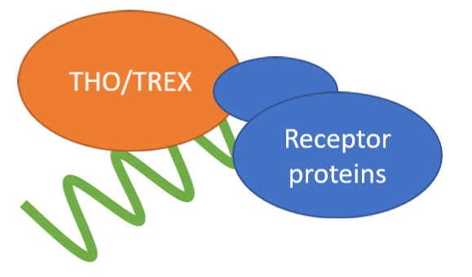
Pre-proinsulin mRNA
As the mRNA emerges into the nucleoplasm it is guided to the Nuclear Pore Complex: Click anywhere for animation.
THO/TREX
Cytoplasm
Nucleoplasm
Where will it go?
Free Ribosome
Rough Endoplasmic Reticulum
RNApol
Receptor proteins
Biomolecules & Cells > Animal Cell Cycle > β-cell Bedlam!

Slide 29
Loose in the cytoplasm
The mRNA escapes into the cytoplasm and is picked up by a free ribosome.
Translation occurs well.
As the newly formed proteins begins to fold a protease arrives
What will it do?
Cleave the signal peptide Do nothing
Biomolecules & Cells > Animal Cell Cycle > β-cell Bedlam!
https://www.pnas.org/content/pnas/104/38/15040.full.pdf

Slide 30
Lost in the cytoplasm
With the signal peptide removed from the new protein, the cell does not know where to take it.
It floats. Aimless. Lost in the cytoplasm.
The insulin protein is picked up by a lysosome.
Proteolytic enzymes degrade the protein.
GAME OVER
Restart
Biomolecules & Cells > Animal Cell Cycle > β-cell Bedlam!
https://www.pnas.org/content/pnas/104/38/15040.full.pdf

Slide 31
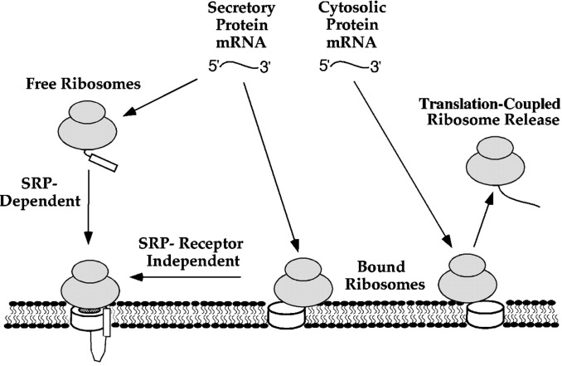
Relocation
With the signal peptide intact, the ribosome migrates down the microtubules to the Rough Endoplasmic Reticulum.
Where will the newly transcribed protein emerge?
Cytoplasm Endoplasmic Reticulum
Biomolecules & Cells > Animal Cell Cycle > β-cell Bedlam!
https://www.jbc.org/article/S0021-9258(20)89082-6/fulltext

Slide 32
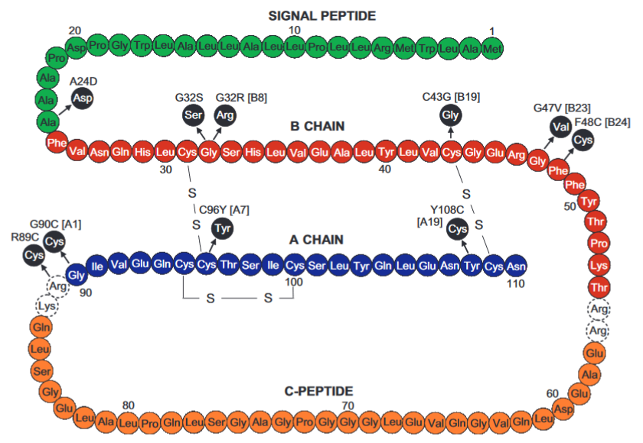


Pre-proinsulin
The insulin emerges into the lumen of the endoplasmic reticulum. The signal peptide (green below) is removed to prevent it being degraded.
Some mutations cause misfolding in insulin.
Click on the image…
Biomolecules & Cells > Animal Cell Cycle > β-cell Bedlam!
https://www.pnas.org/content/pnas/104/38/15040.full.pdf

Slide 33
Signal peptide cannot be removed!
Mutations in the cleavage site for the signal peptide cause the proteolytic enzyme to be ineffectual.
With the signal peptide still attached, the secondary structure (folding) of the insulin is not possible.
The protein is non-functional and is targeted for degradation.
The membrane encapsulates the protein, ejects into the cytoplasm, and the vesicles merges with a lysosome.
GAME OVER
Try again
Biomolecules & Cells > Animal Cell Cycle > β-cell Bedlam!
https://www.pnas.org/content/pnas/104/38/15040.full.pdf

Slide 34
Secondary structure cannot be formed
With the amino acids responsible for the formation of cysteine bridges mutated (changed), the secondary structure (folding) of the insulin is not stable.
The protein is non-functional and is targeted for degradation.
The membrane encapsulates the protein, ejects into the cytoplasm, and the vesicles merges with a lysosome.
GAME OVER
Try again
Biomolecules & Cells > Animal Cell Cycle > β-cell Bedlam!
https://www.pnas.org/content/pnas/104/38/15040.full.pdf

Slide 35
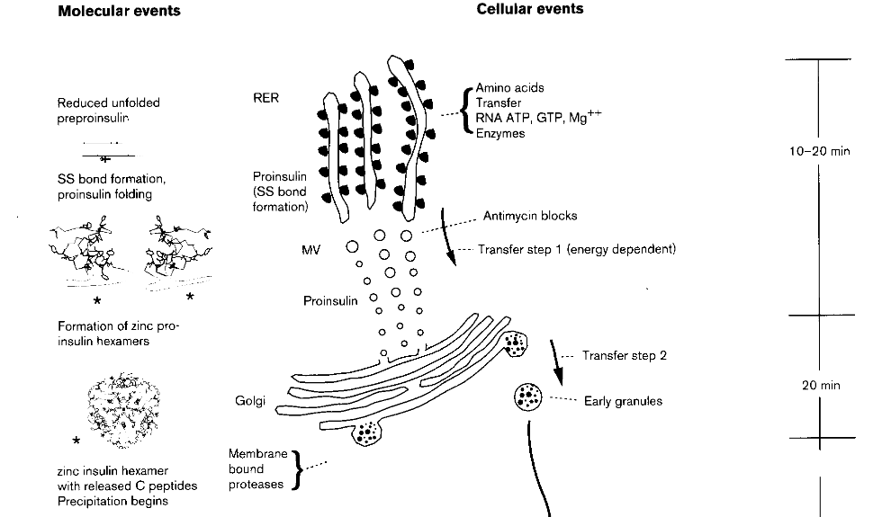
Transport to Golgi & further PTMs
The proinsulin now needs to be migrated to the Golgi apparatus by secretory vesicles from the rough endoplasmic reticulum.
Continue
Biomolecules & Cells > Animal Cell Cycle > β-cell Bedlam!
https://pubmed.ncbi.nlm.nih.gov/9631292/

Slide 36

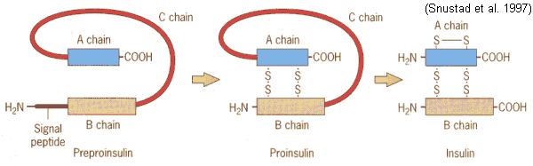
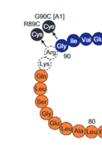
Cleavage and zinc association
The proinsulin now undergoes a double-whammy of PTMs with the cleavage of the C-peptide by Golgi-membrane bound proteolytic enzymes that use zinc as a cofactor.
Zinc is also used as a collating agent to turn monomeric insulin to hexamer (functional) insulin.
Click on the (RHS) image to continue
Biomolecules & Cells > Animal Cell Cycle > β-cell Bedlam!
https://www.pnas.org/content/pnas/104/38/15040.full.pdf
https://www.mun.ca/biology/scarr/Insulin_posttranslational_modification.html

Slide 37
C-peptide cannot be removed!
Mutations in the cleavage site for the C-peptide cause the proteolytic enzyme to be ineffectual.
With the C-peptide still attached, the monomers cannot form the functional hexamer.
The protein is non-functional and is targeted for degradation.
The membrane of the secretory vesicle merges with a lysosome.
GAME OVER
Try again
Biomolecules & Cells > Animal Cell Cycle > β-cell Bedlam!
https://www.pnas.org/content/pnas/104/38/15040.full.pdf

Slide 38
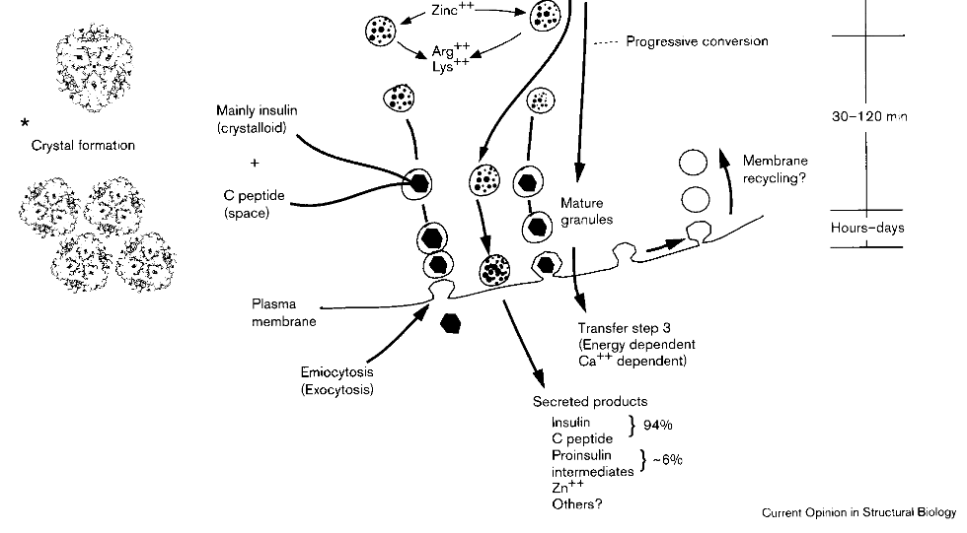
You have secreted insulin!
The Ca²⁺ ions and ATP allow the vesicles containing the insulin hexamers to migrate to the plasma membrane and exocytosis releases the protein into the extracellular matrix
Insulin causes glucose to be stored in the cells and homeostasis returns to the body.
Biomolecules & Cells > Animal Cell Cycle > β-cell Bedlam!
https://pubmed.ncbi.nlm.nih.gov/9631292/

Slide 39
References used
Control of Pancreatic β Cell Regeneration by Glucose Metabolism
G₀-G₁ Transition and the Restriction Point in Pancreatic β-Cells In Vivo
The Roles of Cyclin-Dependent Kinases in Cell-Cycle Progression and Therapeutic Strategies in Human Breast Cancer
How does p53 induce apoptosis and how does this relate to p53-mediated tumour suppression?
Mechanisms of human DNA repair: an update
Potassium Channels Rule over Insulin Release with an Ion Fist
β-cell–mimetic designer cells provide closed-loop glycemic control
Insulin gene mutations as a cause of permanent neonatal diabetes
Exporting RNA from the nucleus to the cytoplasm
On Message Ribonucleic Acids Targeting to Mitochondria
Regulation of Ribosome Detachment from the Mammalian Endoplasmic Reticulum Membrane
The role of assembly in insulin's biosynthesis
Biomolecules & Cells > Animal Cell Cycle > β-cell Bedlam!

